Slide 1
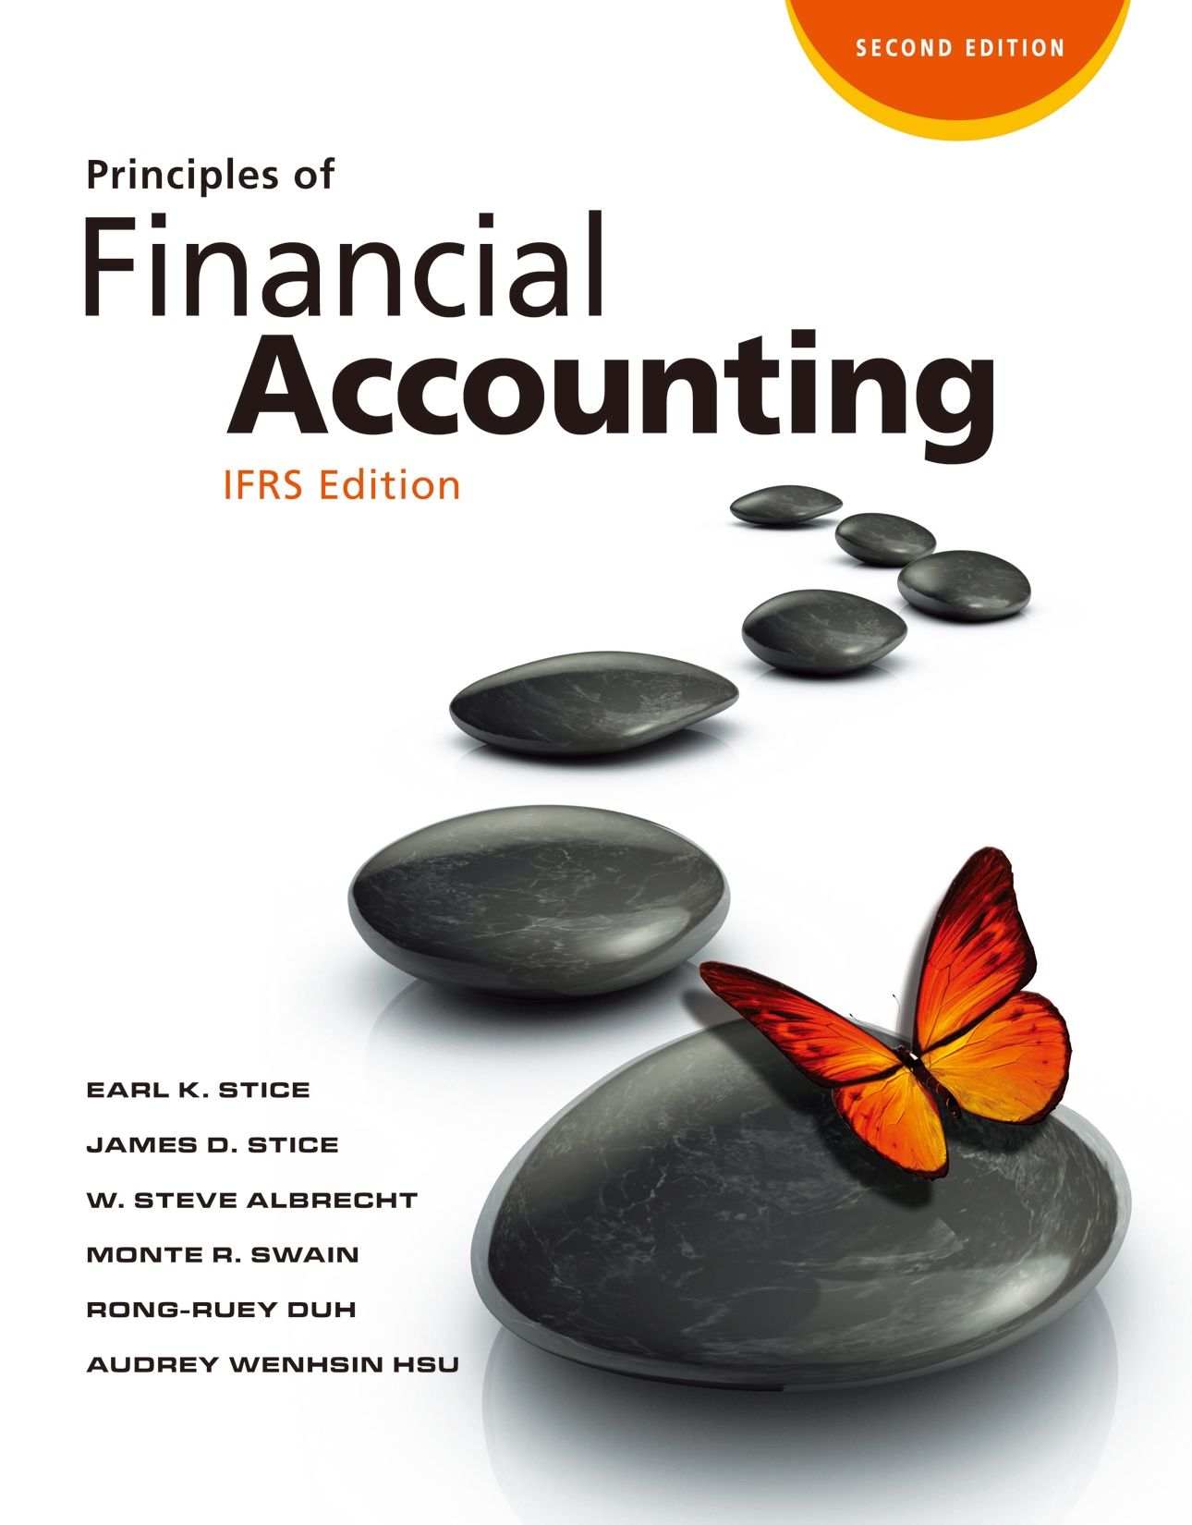

Slide 2
Financial Statements: An Overview

Slide 3
Primary Financial Statements
According to IAS 1, a complete set of financial statements includes
Balance Sheet (Statement of Financial Position)
Statement of Comprehensive Income
Statement of Changes in Equity
Statement of Cash Flows

Slide 4
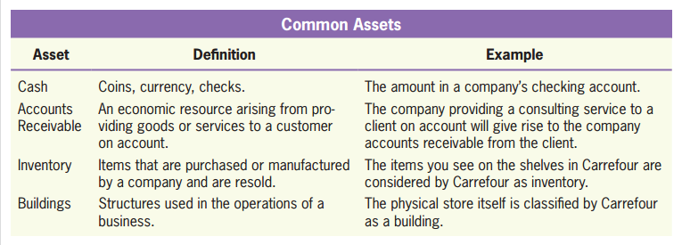
Components of a Balance Sheet
The Balance Sheet
LO1
Assets
A resource controlled by the entity as a result of past events.
Future economic benefits are expected to flow to the entity.
Exhibit 2.1

Slide 5
Components of a Balance Sheet
LO1
Liabilities
A present obligation of the entity arising from past events.
The settlement of which is expected to result in an outflow from the entity of resources embodying economic benefits.

Slide 6
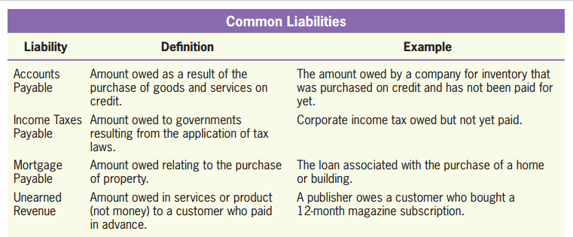
Components of a Balance Sheet
LO1
Liabilities
Exhibit 2.2

Slide 7
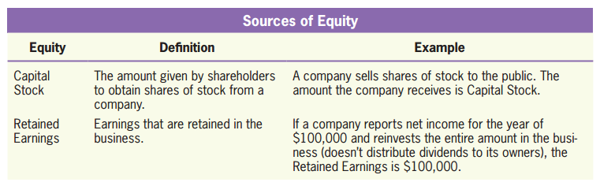
Components of a Balance Sheet
LO1
Equity
The residual interest in the assets of the entity after deducting all its liabilities.
It represents the net assets (Total Assets – Total Liabilities) available after all obligations have been satisfied.
Exhibit 2.3

Slide 8

Ownership of a Company
LO1
Resources
Investors
Business
Ownership
a sole proprietorship
a partnership
a corporation: stockholders (shareholders)

Slide 9

Ownership of a Company
LO1
The portion of equity contributed by owners in exchange for shares of stock is called capital stock.
Dividends
Profits
Stockholders
Retained Earnings
Retained Earnings:
The amount of accumulated earnings of the business that have not been distributed to owners.

Slide 10
Changes of Equity
LO1
Equity increases when
Owners make additional investments in a business.
The business generates profits.
Equity decreases when
Owners take back part of their investment.
Operations generate a loss.
Dividends are distributed to stockholders.

Slide 11
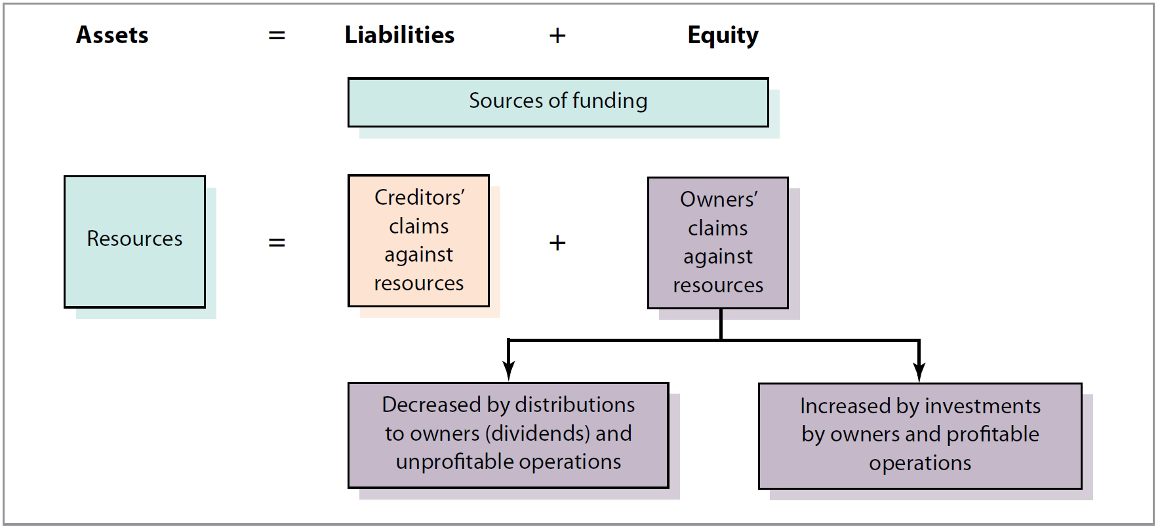
Accounting Equation
LO1
The accounting equation gives you a glimpse of double entry accounting.
Exhibit 2.4

Slide 12
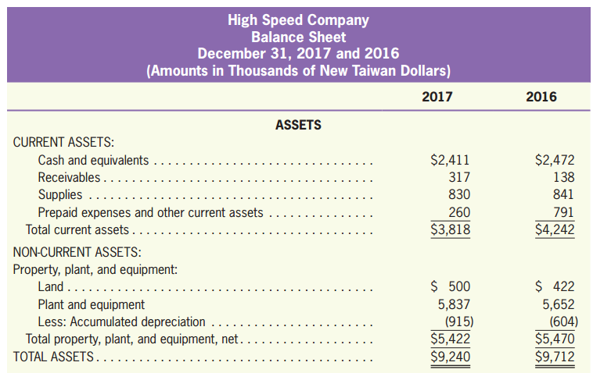
The Format of a Balance Sheet
LO1
a particular date
High
Low
liquidity → Classified Balance Sheet
Exhibit 2.5

Slide 13
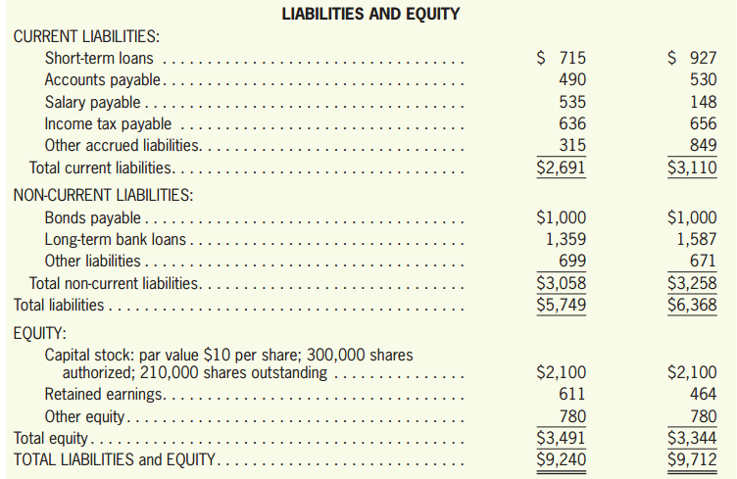
The Format of a Balance Sheet
LO1
High
Comparative
financial statements
Low
liquidity
Exhibit 2.5

Slide 14
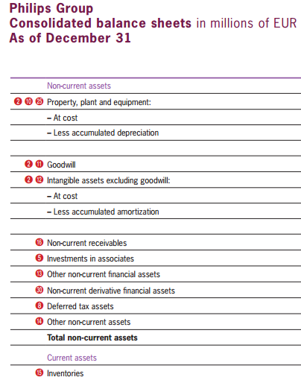
The Format of a Balance Sheet
LO1
INTERNATIONAL
IAS 1(provision 57) does not require the order or format in which a company presents the balance sheet items.
Philips’ balance sheet
liquidity
Low
High

Slide 15
Limitations of a Balance Sheet
LO1
Accountants record many assets at their purchase cost, not at their current market value (e.g., land).
Not all economic assets are included in the balance sheet (e.g., TSMC’s reputation, its technology for semiconductor foundry, and its engineers' talent).

Slide 16
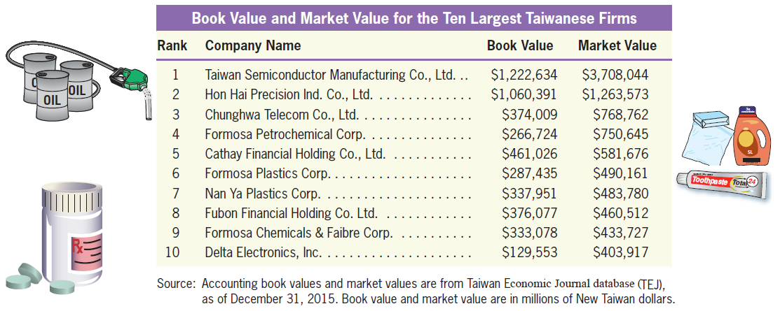
Limitations of a Balance Sheet
LO1
The accounting book value of a company (measured by the amount of equity) is usually less than the company’s market value (measured by the market price per share times the number of shares of stock).
Exhibit 2.6

Slide 17
Quiz Yourself
LO1
Review Philips’ balance sheet in Appendix B and answer the following questions:
What is the amount of Philips’ total reported assets?
Philips’ total reported assets on December 31, 2015, were €30,976 million.
What is the amount of Philips’ total reported liabilities?
Philips’ total reported liabilities on December 31, 2015, were €19,196 (€9,128 + €10,068) million.

Slide 18
Quiz Yourself
LO1
Are Philips’ assets financed more through liabilities or through equity?
Philips’ assets are financed primarily using liabilities.
What is Philips’ largest reported asset?
Philips’ largest reported asset category was Goodwill.
What is Philips’ largest reported current liability and what does that amount represent?
Philips’ largest current liability is Accrued Liabilities with a balance of €2,863 million.

Slide 19
Components of a Statement of Comprehensive Income
The Statement of Comprehensive Income
LO2
Revenues
The amount of assets created through the sale of goods and services.
Expenses
The costs incurred in normal business operations to generate revenues.
Net Income (or Net Loss)
An overall measure of the performance of a company.
Net Income = Revenues – Expenses

Slide 20

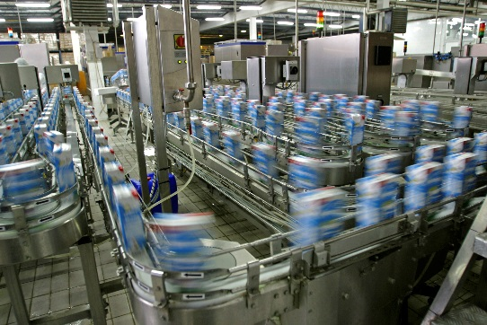

Components of a Statement of Comprehensive Income
LO2
Assets
=
Liabilities
+
Equity
Revenues
Expenses
Net Income
Net Loss

Slide 21
Components of a Statement of Comprehensive Income
LO2
NOT all inflows of assets are revenues.
NOT all outflows of assets are expenses.
Assets
=
Liabilities
+
Equity
Revenues
Borrowing Money from a Bank
Assets
=
Liabilities
+
Equity
Buying Supplies
Expenses

Slide 22
Components of a Statement of Comprehensive Income
LO2
Other Comprehensive Income (OCI)
Includes unrealized gains/losses due to the changes in value of some categories of securities, among others.
OCI is an equity, not revenue or expense.
The balance will be carried forward.
S/CI 2016
OCI | $2,000
S/CI 2017
OCI | $3,000
B/S 2016
OCI | $2,000
2017 ↑ OCI $3,000
B/S 2017
OCI | $5,000

Slide 23
Components of a Statement of Comprehensive Income
LO2
Comprehensive Income
A measure of the overall change in a company’s wealth during a period.
Comprehensive income= Net income + OCI

Slide 24
The Format of a Statement of Comprehensive Income
LO2
Revenues | $ XXX
Expenses | (XXX)
Net income | XXX
Other Comprehensive income | XXX
Comprehensive income | $ XXX

Slide 25
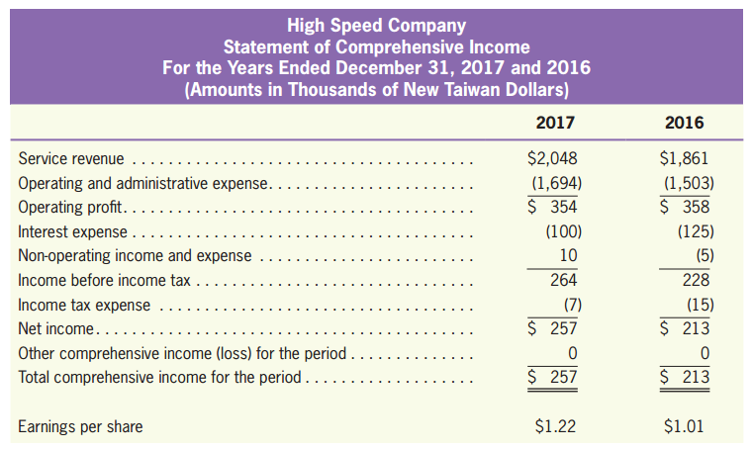
The Format of a Statement of Comprehensive Income
LO2
a period of time
Comparative
financial statements
Exhibit 2.8

Slide 26
The Format of a Statement of Comprehensive Income
LO2
Operating and Non-Operating Categories
Non-operating revenues/ expenses: No connection with the specific nature of the operation of the business.
E.g., interest revenue, interest expense, tax expense, etc.

Slide 27
The Format of a Statement of Comprehensive Income
LO2
Gains or Losses
Refer to money made or lost on activities outside the normal business of a company.
For example, Philips makes money from selling an old truck.
Gains or losses are expressed in net amount, whereas revenues or expenses are in gross amount.

Slide 28
The Format of a Statement of Comprehensive Income
LO2
Earnings (Loss) per Share
The amount of net income (earnings) related to each share of stock.
Earnings per share information tells the owner of a single share of stock how much of the net income for the year belongs to him or her.
Net Income
EPS
=
Outstanding Number of Shares of Stock

Slide 29
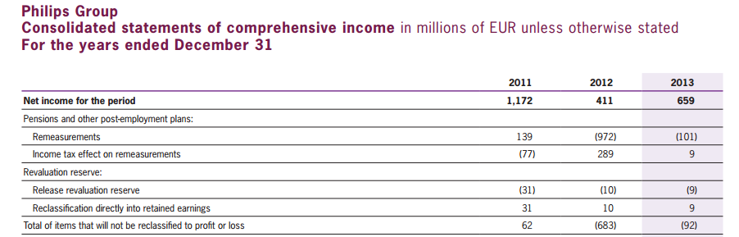
The Format of a Statement of Comprehensive Income
LO2
Single Statement vs. Two Separate Statements
IAS 1 allows a company to present the comprehensive income in two separate statements: an income statement, and a statement of comprehensive income that starts with the amount of net income.
Philips’ Statement of Comprehensive Income

Slide 30
Quiz Yourself
LO2
Review Philips’ statement of comprehensive income in Appendix B and answer the following questions:
What was Philips’ net income for the fiscal year ended December 31, 2015?
Philips’ net income for 2015 was €659 million.
How much were Philips’ income tax expense for the fiscal year ended December 31, 2015?
Philips’ income tax expense for 2015 was €239 million.

Slide 31
Quiz Yourself
LO2
What was Philips’ other comprehensive income (loss) for the fiscal year ended December 31, 2015?
Philips’ other comprehensive income for 2015 was €791 million.
What was Philips’ total comprehensive income for the fiscal year ended December 31, 2015?
Philips’ total comprehensive income for 2015 was €1,450 million.

Slide 32
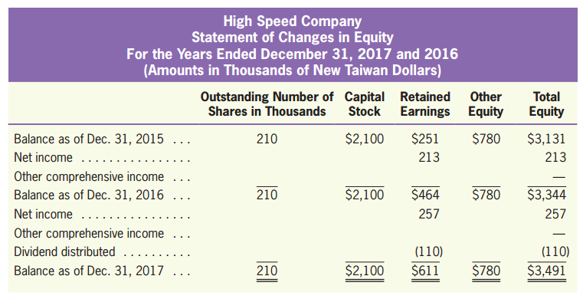
The Statement of Changes in Equity
The Statement of Changes in Equity
LO3
Reports the changes in the elements of equity during a period of time.
Exhibit 2.9

Slide 33
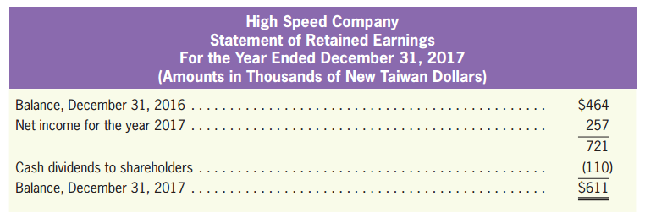

The Statement of Retained Earnings
LO3
Shows the changes in retained earnings during a period of time.
Ending R/E= Beginning R/E+ Net Income- Dividends
from statement of comprehensive income
Exhibit 2.10
to balance sheet

Slide 34


What is Retained Earnings?
LO3
Retained earnings is the amount of a business’s earnings that have been retained in the business, and is used to reinvested back into the business or pay down debt.
The earnings that have not been retained in the business have been distributed to owners in the form of a dividend.
Earnings
Reinvestment or repayment of debts
Distribution of dividends

Slide 35
What isn’t Retained Earnings
LO3
Retained earnings is not cash.
Sometimes it may be in the form of cash, but it is more likely that the cash has been used to purchase other assets or to pay off liabilities.

Slide 36
The Statement of Cash Flows
The Statement of Cash Flows
LO4
Shows the cash inflows (receipts) and outflows (payments) of an entity during a period of time.
In the statement of cash flows, individual cash flow items are classified according to three main activities
Operating activities
Investing activities
Financing activities

Slide 37
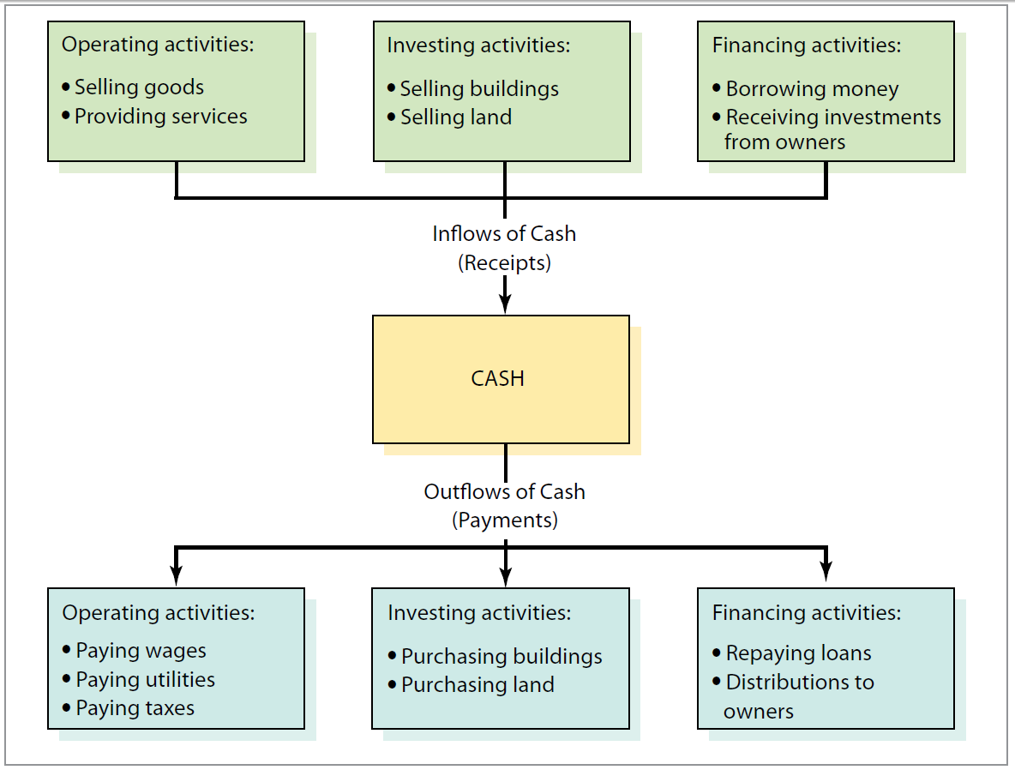
The Statement of Cash Flows
LO4
Exhibit 2.11

Slide 38
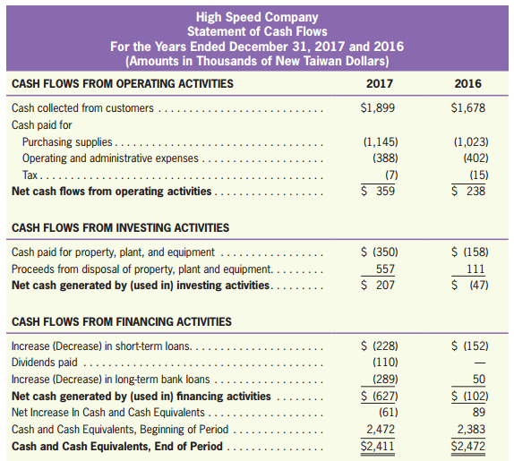
The Statement of Cash Flows
LO4
Exhibit 2.12

Slide 39
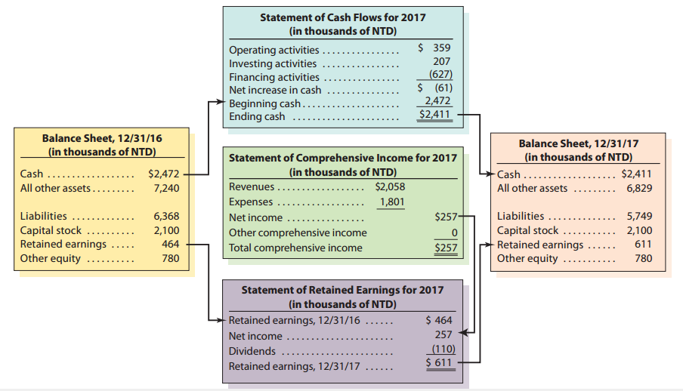
How the Financial Statements Tie Together
LO4
Exhibit 2.13

Slide 40
Notes to the Financial Statements
Notes to the Financial Statements
LO5
Explanatory information considered an integral part of the financial statements.
Financial statement notes fall into four general categories:
Summary of Significant Accounting Policies
Additional Information about the Summary Totals
Disclosure of Information Not Recognized
Supplementary Information (required by the IASB)

Slide 41
The External Audit
The External Audit
LO6
A company’s financial statements are often audited by an independent certified public accountant (CPA).
A CPA firm issues an audit report that expresses an opinion about whether the statements in accordance with generally accepted accounting principles.
The financial statements are the responsibility of a company’s management and not of the CPA.
An audit report does not guarantee accuracy, but it does provide added assurance that the financial statements are not misleading.

Slide 42
The External Audit
LO6
Owners and managers want the most favorable results possible.
Bank credit
Bonuses
Public stock price
CPA firms have economic incentives to perform credible audits.
Reputation
Lawsuits

Slide 43
Quiz Yourself
LO6
Review Philips’ audit report in Appendix B and answer the following questions:
Which independent firm provided the audit for Philips?
KPMG Accountants N.V., one of the large international accounting firms, has audited Philips’ financial statements for many years.

Slide 44
Quiz Yourself
LO6
Philips has operations in more than 100 countries, over 115,000 employees, and sales of over €24.2 billion. How long did it take from the end of Philips’ business year until the audit report was issued?
The date of KPMG’s audit report is February 23, 2016. Philips’ fiscal year ended on December 31,2015. KPMG was able to complete its audit in less than 60 days. Obviously, much audit work was conducted during the year to make this happen.

Slide 45
Fundamental Concepts and Assumptions
Fundamental Concepts and Assumptions
LO7
The Separate Entity Concept
An entity is defined as the organizational unit for which accounting records are maintained.
In the separate entity concept, the activities of an entity are to be separated from those of the individual owners.

Slide 46
Fundamental Concepts and Assumptions
LO7
The Time-Period Assumption
The idea used to report the results of activities over a standard time period, which is usually monthly, quarterly, or annually.
With the time-period assumption, financial statements can be periodically prepared whereby investors and creditors can be informed of performance of the business.

Slide 47
Fundamental Concepts and Assumptions
LO7
The Assumption of Arm’s-Length Transactions
Business dealings between independent and rational parties who are looking out for their own interests.
The Cost Principle
The idea that transactions are recorded at their historical costs or exchange prices at the transaction date.

Slide 48
Fundamental Concepts and Assumptions
LO7
The Fair Value Principle
The idea that assets and liabilities be measured at fair value so that the relevance of accounting information can be improved.
In some instances, IFRS allows companies to choose either historical cost or fair value approach (such as fixed asset valuation).

Slide 49
Fundamental Concepts and Assumptions
LO7
The Monetary Measurement Concept
The idea that
Money is the accounting unit of measurement.
Only economic activities measurable in monetary terms are included in the accounting model.

Slide 50
Fundamental Concepts and Assumptions
LO7
The Going Concern Assumption
The idea that an accounting entity will have a continuing existence for the foreseeable future.
Allows the accountant to record assets at what they are worth to a company in normal use, rather than what they would sell for in a liquidation sale.

